Slide 1
Tower of Hanoi

Slide 2
Introduction to the problem:
The Tower of Hanoi is a famous mathematical puzzle that has intrigued mathematicians and puzzle enthusiasts for centuries.
It was invented by the French mathematician Édouard Lucas in 1883 and is named after the city of Hanoi, Vietnam.
The puzzle consists of three rods and a set of disks of different sizes, initially stacked on one rod.
The objective is to move the entire stack of disks to another rod, following specific rules.

Slide 3
Explanation of the puzzle
The Tower of Hanoi puzzle starts with the disks arranged in decreasing order of size on one rod, often referred to as the "source" rod.
The other two rods are initially empty and are called the "auxiliary" rod and the "destination" rod.
The challenge is to transfer the entire stack of disks from the source rod to the destination rod, adhering to three fundamental rules:
Only one disk can be moved at a time.
Each move involves taking the top disk from one rod and placing it on top of another rod or an empty rod.
At any point during the puzzle, no disk can be placed on top of a smaller disk.

Slide 4
Problem Statement
The Tower of Hanoi problem is a mathematical puzzle that consists of three rods and a number of disks of different sizes.
The puzzle starts with the disks in a stack on one rod, arranged in increasing order of size from top to bottom.
The objective is to move the entire stack to another rod, obeying the following rules:
Only one disk can be moved at a time.
Each move consists of taking the top disk from one of the stacks and placing it on top of another stack or an empty rod.
No disk may be placed on top of a smaller disk.

Slide 5
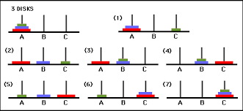
Example
Visual representation of the initial state of the Tower of Hanoi problem with 3 disks on the first rod.
Show the three rods labeled A, B, and C.

Slide 6
Solution Approach
Explain the recursive approach to solve the Tower of Hanoi problem:
Move n-1 disks from the source rod to the auxiliary rod.
Move the largest disk from the source rod to the destination rod.
Move the n-1 disks from the auxiliary rod to the destination rod.
Describe the base case when the number of disks is 1.

Slide 7
Applications
Algorithm Design: It is an example of a recursive algorithm, showcasing the divide-and-conquer approach.
Problem Solving: It develops critical thinking and problem-solving skills, applicable to various real-world scenarios.
Computer Science: It is used to test algorithm efficiency and explain recursion, stack operations, and time complexity analysis.
Disk Movement Planning: It represents orderly movement of objects between locations, relevant to manufacturing and logistics.
Puzzle Design and Recreational Mathematics: It is a popular puzzle and a topic in recreational mathematics.
Analogies in Decision Making: The problem's rules and constraints can be applied as analogies in decision-making processes.

Slide 8
Time Complexity
The time complexity of the Tower of Hanoi problem is O(2^n), where n is the number of disks.
The exponential time complexity arises due to the recursive nature of the problem.
As the number of disks increases, the total number of moves required grows exponentially.
For n disks, the total number of moves can be represented as 2^n - 1.
This means that even a small increase in the number of disks can result in a significant increase in the number of moves required.
It's important to consider this exponential time complexity when analyzing and solving the Tower of Hanoi problem, especially for larger problem sizes.

Slide 9
Time Complexity
To understand the time complexity, let's consider an example:
With 1 disk, only one move is required.
With 2 disks, a total of three moves are needed.
With 3 disks, a total of seven moves are required.
With 4 disks, a total of 15 moves are needed.
And so on...

Slide 10
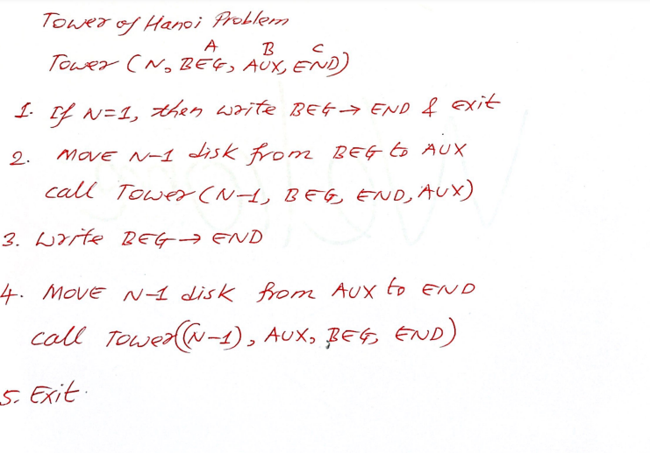

Slide 11
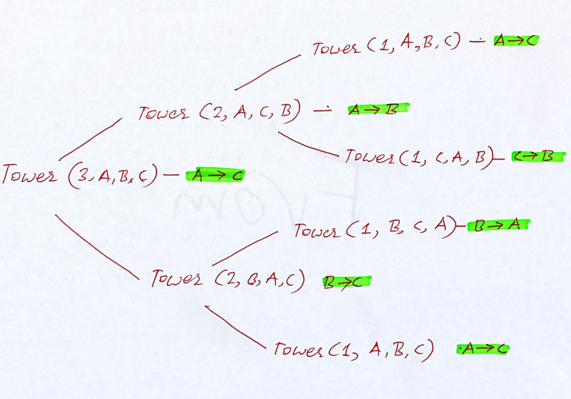

Slide 12
